Slide 1
Substation and Distribution Automation
Module 6: Volt-VAR optimization

Slide 2
Module 6 Overview
Part 1: Traditional Voltage Control
Part 2: Volt-VAR Optimization

Slide 3
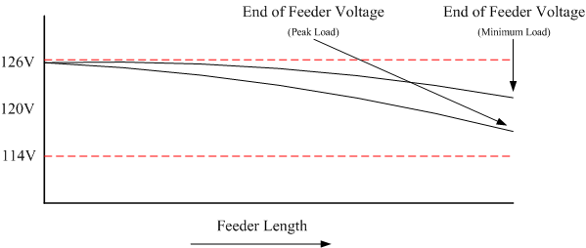
Part 1: Traditional Voltage Control
The voltage supplied to the customer is generally maintained within the limits set by ANSI C84.1, 120V +/-5%.
This is done by setting the voltage at the “head” of the feeder at the high end of the band, to ensure that the voltage drop at peak load does not exceed limits.

Slide 4
Traditional Voltage Control Cont. (Regulators)
Regulators are often installed at the substation in order to adjust the voltage at the head of the feeder.

Slide 5
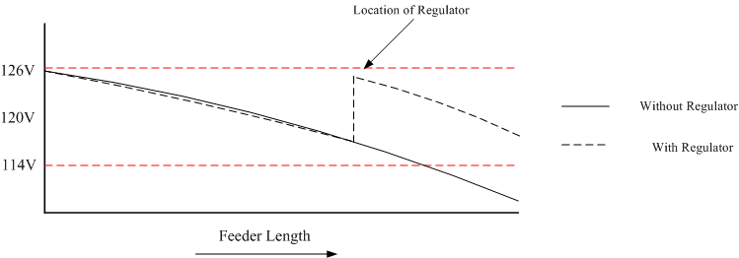
Traditional Voltage Control Cont. (Regulators)
In extreme cases a down stream voltage regulator can be installed.

Slide 6
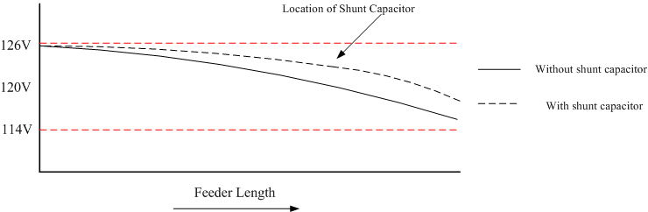
Traditional Voltage Control (Capacitors)
If the feeder is heavily loaded then a shunt capacitor can be installed to raise the voltage.
This also reduces the reactive power needs of the feeder, reducing losses.

Slide 7
Operation of Voltage Control Devices
Voltage control devices, both regulators and shunt capacitors, traditionally have been operated in a stand alone mode.
Operation is achieved through manual operation, local set points, and on occasion remote measurements.
While the set points may be coordinated, it is a static coordination and does not account for time dependant variations in the system behavior.

Slide 8
Part 2: Volt-VAR Optimization
In contrast to the traditional operational methods, Volt-VAR Optimization controls multiple devices to achieve a global optimum.
Volt-VAR Optimization, and the associated global optimum(s), exists in many forms.
The general principle is to control the voltage and reactive power on a distribution feeder so that load can be managed.
One example of VVO:
Voltage optimization involves “flattening” the voltage profile and possibly lowering the level.
VAR optimization involves controlling the flow of reactive power, which has an impact on voltage.

Slide 9
Volt-VAR Optimization
Voltage Reduction
When lowering the voltage it is necessary to ensure that the voltage on all points of the system remain within specifications.
The use of End Of Line (EOL) measurements can help to ensure that voltages at remote points are not too low.
This is similar to operating a regulator in “REMOTE” except that there can be multiple measurement points.
VAR Optimization
When capacitors operate based on local readings there is no regard for the rest of the system.
VAR optimization allows capacitors to work in a coordinate manner to reduce overall reactive power flows, thus reducing system losses.

Slide 10
Volt-VAR Optimization Cont.
There are numerous Volt-VAR optimization options commercially available:
General Electric: Coordinated Volt-VAR Control
Cooper: Integrated Volt VAR Control
ABB: Volt VAR Optimization
PCS UtiliData: AdaptiVolt
The capabilities and cost of these commercially available products varies.
There are also numerous academic papers on the topic. We will examine the following method:
“V. Borozan, M. Baran, and D. Novosel, “Integrated Volt/VAR Control in Distribution Systems”, IEEE PES Winter Meeting, 2001.”

Slide 11
Borozan, Baran, and Novosel Implementation
Simple control scheme
Works for radial feeders
No “cross branch” optimization – each “regulator branch” handled independently
No downstream coordination – branches with multiple regulators may have voltage violations while things move
Assumes no reverse energy power flow
Two-stage process
Primary goal: optimize voltage – move the voltage to a desired set point
Secondary goal: optimize reactive power – switch capacitors to maintain power factor

Slide 12
Borozan, Baran, and Novosel Implementation Cont.
Stage 1: Voltage Optimization Objectives
Determine the minimum voltage
Determine “state of the system”
Command regulators
Stage 2: Reactive Power Optimization Objectives
Determine reactive power value
Find next capacitor to switch
Command capacitors

Slide 13
Borozan, Baran, and Novosel VVO Control Strategy
Voltage Optimization
Reactive Power Optimization
Determine minimum measured voltage.
Compute the voltage drop between regulator and minimum voltage point.
Apply voltage drop to desired voltage to obtain corrected desired voltage.
Ensure corrected desired voltage does not exceed the minimum or maximum ratings
Determine if high-loading or low-loading dead band should be used.
Determine if corrected desired voltage is outside the dead band.
If tap change, ensure the estimated new voltage will not exceed the minimum and maximum values of the system
If new voltage is acceptable, change taps of regulator
Determine the reactive power on the line of interest and computer the power factor.
Determine if the power factor is below the desired power factor.
Operate capacitors as necessary to bring the power factor into the desired range.
Only one capacitor is operated per cycle.

Slide 14
VVO-Regulators – Voltage Optimization
Determine minimum voltage in measurements and regulator load-side voltage
minimum voltage (V_{min}) is the lowest voltage measured associated with that regulator. It could be the load side of the regulator (regulator load-side voltage (V_{reg_load})) or an end-of-line measurement (V_{EOL}).
Compute voltage drop (V_{drop}) between regulator and minimum voltage
Apply voltage drop to desired voltage (V_{des}) to obtain corrected desired voltage (V_{corr_des})

Slide 15
VVO-Regulators – Voltage Optimization
Ensure corrected desired voltage does not exceed the minimum or maximum ratings of the system (V_{sys_min} or V_{sys_max})
Determine if in high-loading or low-loading deadband (V_{deadband}) conditions by examining voltage drop
Tap-changing conditions can be determined based on a high or low load voltage drop condition
Under high loading, the voltage may want to be constrained more
e.g., a high loading condition may have:
a low loading may have:
V_{tap} is the ideal voltage change associated with a tap change on the regulator

Slide 16
VVO-Regulators – Voltage Optimization
Determine if corrected desired voltage is outside the deadband of current set voltage (V_{curr_set})
If tap change, ensure the estimated new voltage will not exceed the minimum and maximum values of the system
V_{tapchange} is the V_{tap} in the appropriate direction (+ for tap up, - for tap down)

Slide 17
VVO-Regulators – Voltage Optimization
If new voltage is acceptable, change taps of regulator
Tap change is pushed to the regulator directly, not a voltage set point (i.e., the regulator is commanded “tap up”, not “set voltage to 2500”)
Downstream regulators are not coordinated, so upstream changes may move them into a voltage violation

Slide 18
VVO-Capacitors – Reactive Power Optimization
Only occurs if no regulator changes are requested
Determine reactive power (Q_{line}) on line of interest (substation transformer) – compute the current power factor (PF_{curr}) from the reactive power and real power (P_{line}) of the line
Note that PF_{curr} and Q_{line} are treated more like power factor magnitude and reactive power magnitude. The VVO algorithm assumes normal radial feeders with predominately inductive loading (no predominately capacitive loads or reverse power flow)

Slide 19
VVO-Capacitors – Reactive Power Optimization
Determine if power factor is below the desired power factor (PF_{des})
If outside range, proceed through capacitors – only change one per operation cycle:
Determine capacitor size, (P_{CAP}) – adds together all phases
Sort capacitors by size, largest to smallest, closest to farthest
Switching thresholds (Q_{cap_off}, Q_{cap_on}) are determined by d_{min} and d_{max} ratio constants – create hysteresis-like condition

Slide 20
VVO-Capacitors – Reactive Power Optimization
If outside range, proceed through capacitors – only change one per operation cycle – dependent on state and size:
ON and
Capacitor ON and reactive power < Q_{cap_off}: switch capacitor to OFF
OFF and
Capacitor OFF and reactive power > Q_{cap_on}: switch capacitor to ON
Neither met
Proceed to next largest capacitor and continue check

Slide 21
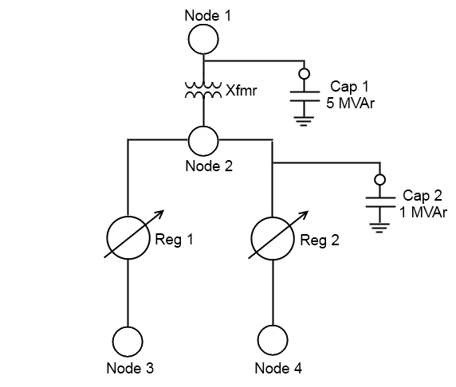
Volt-VAR Optimization – Example
Simple “4-node” system
Nodes represent measurements
Two Regulators
Two Capacitors
Assume regulators have 100 V tap positions
4700 V end of line desired
0.99 pf desired
Minimize reactive flow through Xfmr

Slide 22
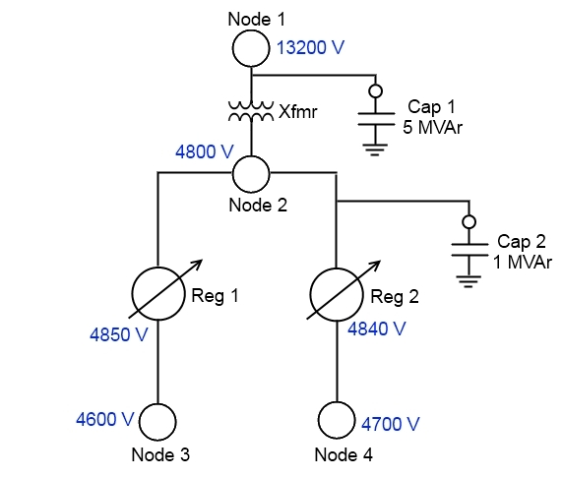
Volt-VAR Optimization Example – Initial Voltages
Determine minimum voltage and regulator load-side voltages
Reg 1 – 4850 V and 4600 V
Reg 2 – 4840 V and 4700 V
1a. Evaluate voltages
Reg 1 end-of-line voltage is low
Reg 2 is acceptable

Slide 23
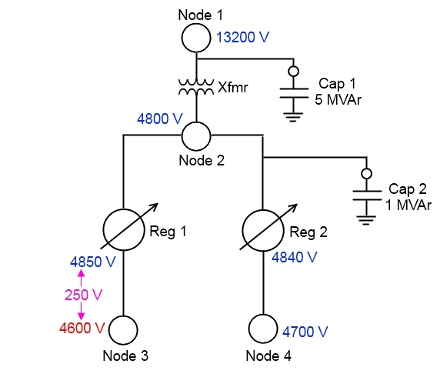
Volt-VAR Optimization Example – Condition Evaluation
Compute voltage drop between regulator and minimum voltage
Reg 1 – 250 V
Reg 2 – No action needed, but 140 V drop

Slide 24
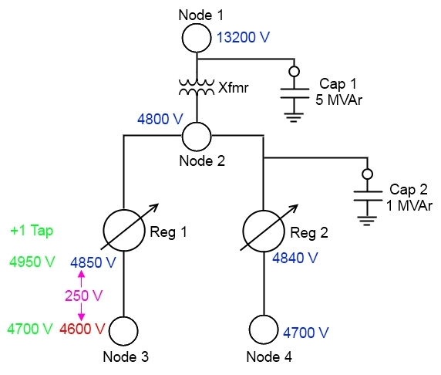
Volt-VAR Optimization Example – Corrective Actions
Corrected desired voltage for Reg 1 is 4950 V
(4700 desired + 250 V drop)
Reg 1 is assumed to have an available position to “tap up”
4950 V is assumed to not violate the upper voltage limit
250 V drop is considered high-loading
Deadband is assumed to be +/- 1 tap (+/- 100 V)

Slide 25
Volt-VAR Optimization Example – Corrective Actions (continued)
Outside the deadband of desired voltage
+1 tap change is desired
New voltage will be 4950 V
4850 V current + 100 V tap up
Will not violate upper voltage limit
Value of new voltage acceptable
Execute tap change

Slide 26

Volt-VAR Optimization Example – Voltage Result
All voltages at desired values
If Node 3 were still unacceptable, process would repeat
Adjustment could occur simultaneous to Reg 2/Node 4 adjustments

Slide 27
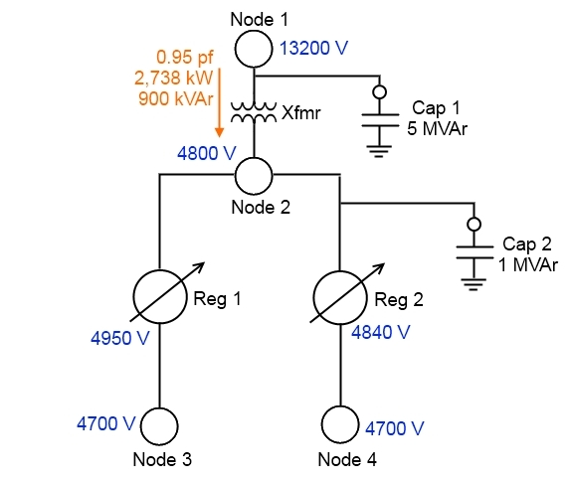
Volt-VAR Optimization Example – Reactive Power Values
Only occurs once voltage changes have completed
Determine reactive power and compute power factor
900 kVAr of reactive power
0.95 power factor
Determine if below desired power factor
0.99 desired power factor, so is below (action needed)

Slide 28
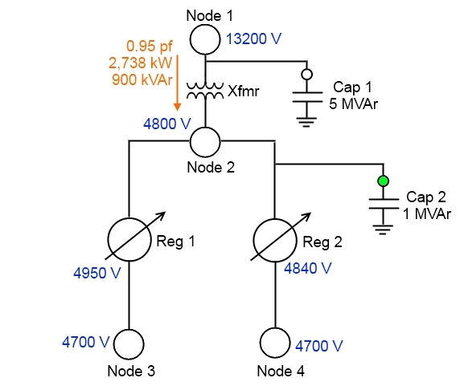
Volt-VAR Optimization Example – Reactive Power Correction
Outside range, proceed through capacitors
Use default d_min of 0.3 and d_max of 0.6
5 MVAr capacitor
0.6 * 5 MVAr = 3.0 MVAr – too big, no action
1 MVAr capacitor
0.6 * 1 MVAr = 0.6 MVAr – under limit, switch it in

Slide 29
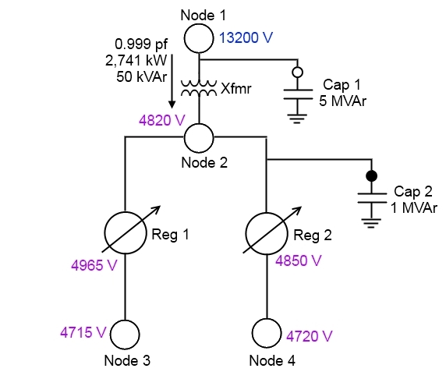
Volt-VAR Optimization Example – Reactive Power Result
Evaluate results
If no voltage changes are required, proceed
If more reactive changes required, rescan the capacitor list
Capacitor changes can influence voltages
May exceed limits
Can cause regulator and capacitor “fighting” in this simple algorithm

Slide 30
Integrated Volt/VAR Control in Distribution Systems
This is an openly available Volt-VAR control system that has been implemented in GridLAB-D.
It is composed of two coordinated goals.
Voltage reduction
VAR control

Slide 31
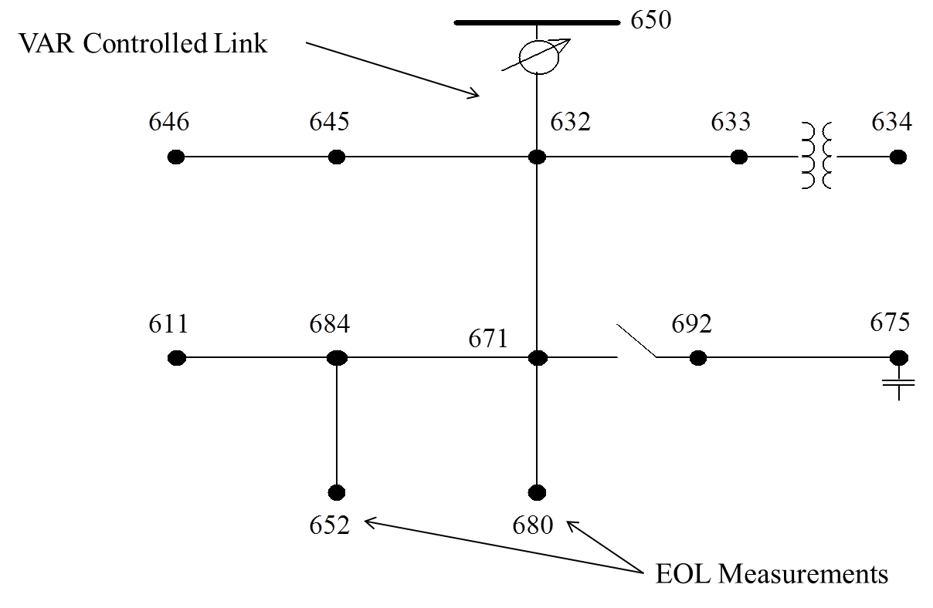
Modified IEEE 13 Node System with Volt-VAR Control
The model has been modified from the original test feeder in order to examine voltage control issues.
It is a 2,400V nominal system.
A voltage regulator is between node 650 and 632.
It operates to regulate the voltage at a remote node, node 671.
The normal dead band is +/- 30 V.
Capacitors have been added at node 675.
Operate to maintain the voltage at node 675.

Slide 32
Volt-VAR Examples
Case 1: Comparison of voltage regulation between local control and VVO at 2400V.
Case 2: Examination of VVO at 2300V
Case 3: VVO at 2400V with different EOL measurements.
Case 4: Change of the remote sense node (Local control).
Case 5: Local Voltage Control
Case 6: VVO at 2200V
Case 1: Local Voltage Control and 2400 compared for regulation
Case 2: VVO at 2400 V
Case 3: VVO at 2300 V
Case 4: VVO at 2200V

Slide 33
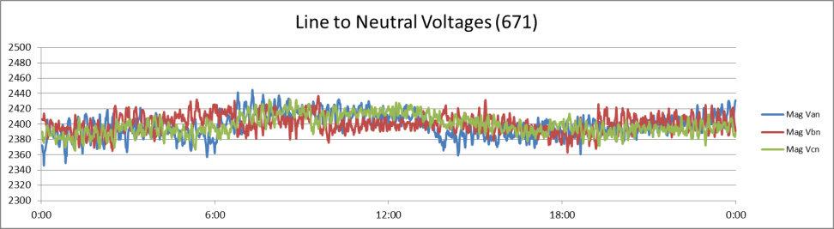
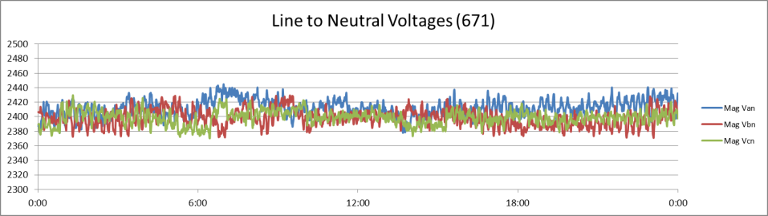
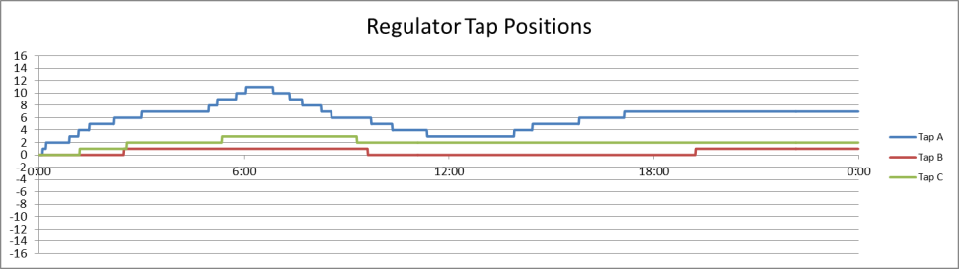
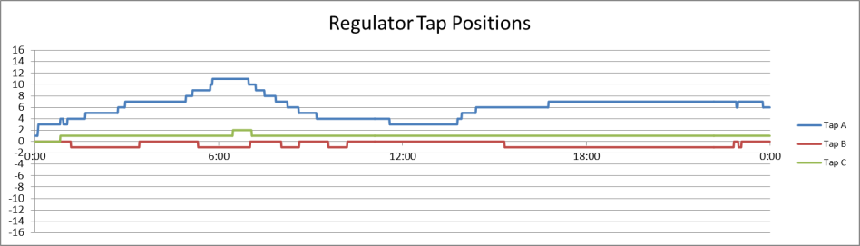






Case 1
Local Voltage Control only
Voltage at node 671 controlled by regulator to 2400V
Voltage at node 675 maintained by capacitors
Coordinated Volt-VAR control implemented
Voltage is regulated at nodes 652 and 680 to 2400V
Better regulation is achieved
$$\%VR_{A}=\frac{V_{min}−V_{peak}}{V_{peak}}=\frac{2444.98−2345.83}{2345.83}=4.23\%$$
$$\%VR_{A}=\frac{V_{min}−V_{peak}}{V_{peak}}=\frac{2444.47−2376.00}{2376.00}=2.88\%$$
$$\%VR_{B}=\frac{V_{min}−V_{peak}}{V_{peak}}=\frac{2436.77−2362.80}{2362.80}=3.13\%$$
$$\%VR_{B}=\frac{V_{min}−V_{peak}}{V_{peak}}=\frac{2429.39−2371.06}{2371.06}=2.46\%$$
$$\%VR_{C}=\frac{V_{min}−V_{peak}}{V_{peak}}=\frac{2432.39−2365.38}{2365.38}=2.83\%$$
$$\%VR_{C}=\frac{V_{min}−V_{peak}}{V_{peak}}=\frac{2429.71−2370.37}{2370.37}=2.50\%$$

Slide 34
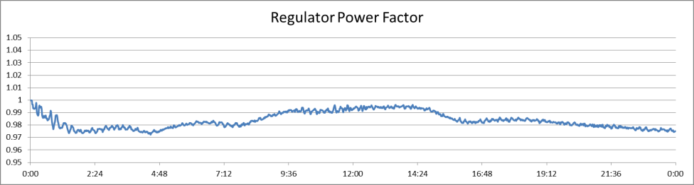
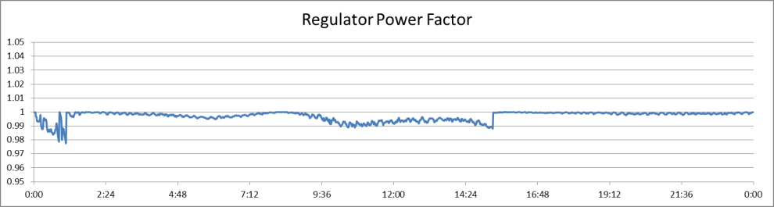
Case 1 (continued)
Local voltage control only
Volt-VAR control implemented
P (kWh-hr) | 38,730
Q(kVAR-hr) | 7,225
S(KVA-hr) | 39,427
P (kWh-hr) | 38,736
Q(kVAR-hr) | 1,933
S(KVA-hr) | 38,878
Average pf: 0.983690316
Average pf: 0.996980636
Using Coordinated Volt/VAR control as opposed to local voltage control alone resulted in:
Better regulation
Reduced Energy consumption
Better maintenance of power factor at the desired level

Slide 35

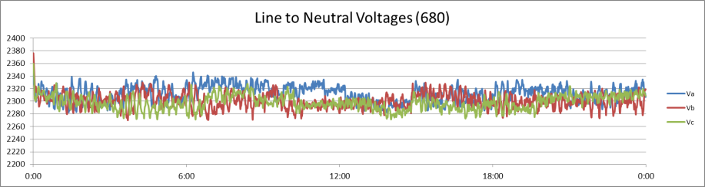
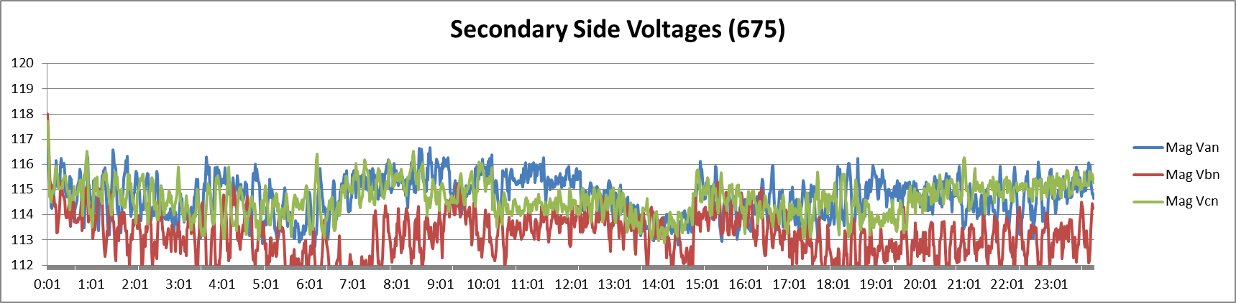



Case 2a
Regulate voltage to 2300V instead of 2400V at nodes 652 and 680 using VVC .
Voltage is well regulated, power factor is maintained, and reduction in energy consumption is observed.
However, the secondary side voltage measurements at an end-of-line node show values often dipping well below 114V.
$$\%VR_{A}=\frac{V_{min}−V_{peak}}{V_{peak}}=\frac{2337.00−2270.01}{2270.01}=2.95\%$$
$$\%VR_{B}=\frac{V_{min}−V_{peak}}{V_{peak}}=\frac{2376.3−2270.18}{2270.18}=4.67\%$$
$$\%VR_{C}=\frac{V_{min}−V_{peak}}{V_{peak}}=\frac{2359.15−2269.54}{2269.54}=3.95\%$$
P (kWh-hr) | 38,399
Q(kVAR-hr) | 2,292
S(KVA-hr) | 38,555

Slide 36

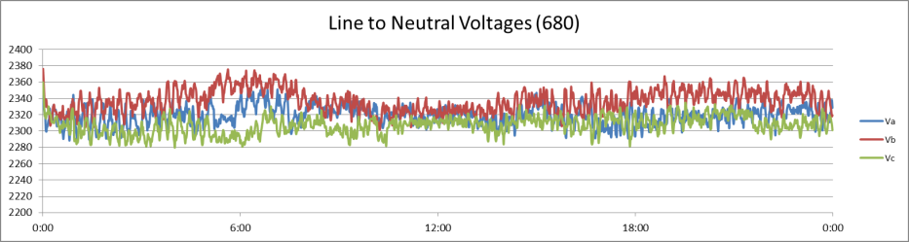
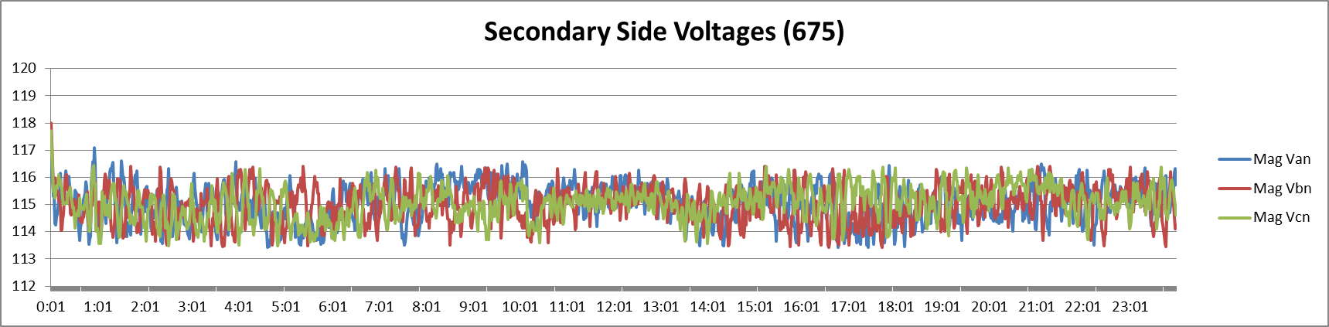



Case 2b
Switch from measuring voltage at nodes 652 and 680 to measuring at nodes 652 and 675.
Voltage is even better regulated and power factor is maintained.
Energy consumption is a little higher, but still lower than regulating at 2400V.
The secondary side voltage measurements at an end-of-line node show values are now in a more reasonable range.
$$\%VR_{A}=\frac{V_{min}−V_{peak}}{V_{peak}}=\frac{2339.01−2274.71}{2274.71}=2.83\%$$
$$\%VR_{B}=\frac{V_{min}−V_{peak}}{V_{peak}}=\frac{2376.30−2301.45}{2301.45}=3.25\%$$
$$\%VR_{C}=\frac{V_{min}−V_{peak}}{V_{peak}}=\frac{2359.15−2278.40}{2278.40}=3.54\%$$
P (kWh-hr) | 38,465
Q(kVAR-hr) | 2,332
S(KVA-hr) | 38,621

Slide 37
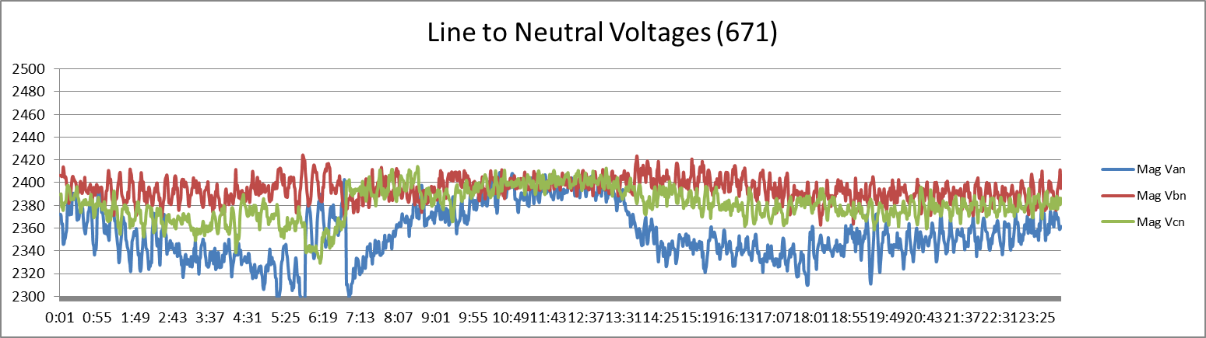
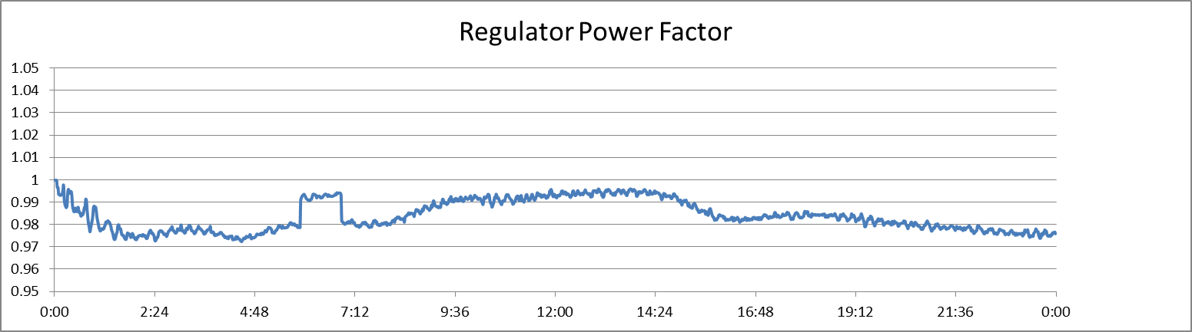



Case 3a
Change the sense node of the regulator from 671 to 632.
Using local voltage control only, the voltage at node 671 is not well regulated.
The power factor is not maintained.
$$\%VR_{A}=\frac{V_{min}−V_{peak}}{V_{peak}}=\frac{2409.08−2276.42}{2276.42}=5.83\%$$
$$\%VR_{B}=\frac{V_{min}−V_{peak}}{V_{peak}}=\frac{2424.25−2362.71}{2362.71}=2.60\%$$
$$\%VR_{C}=\frac{V_{min}−V_{peak}}{V_{peak}}=\frac{2414.26−2329.21}{2329.21}=3.65\%$$
P (kWh-hr) | 38,655
Q(kVAR-hr) | 7,067
S(KVA-hr) | 39,337

Slide 38
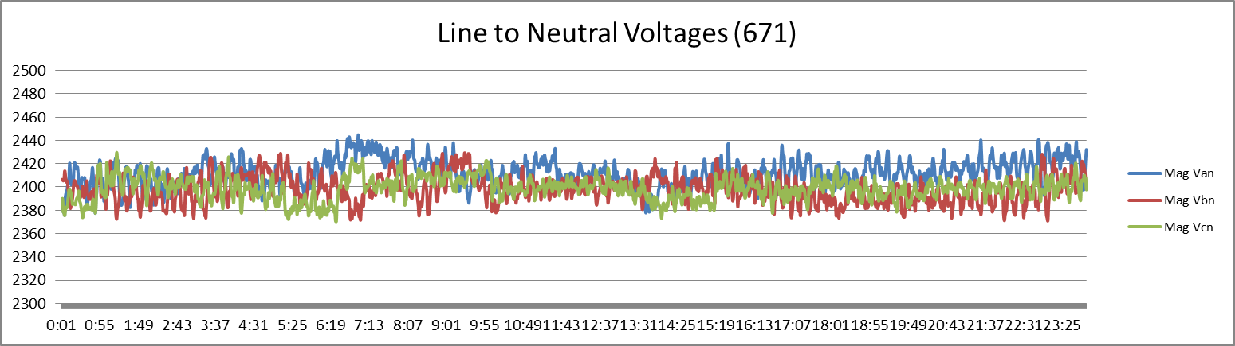
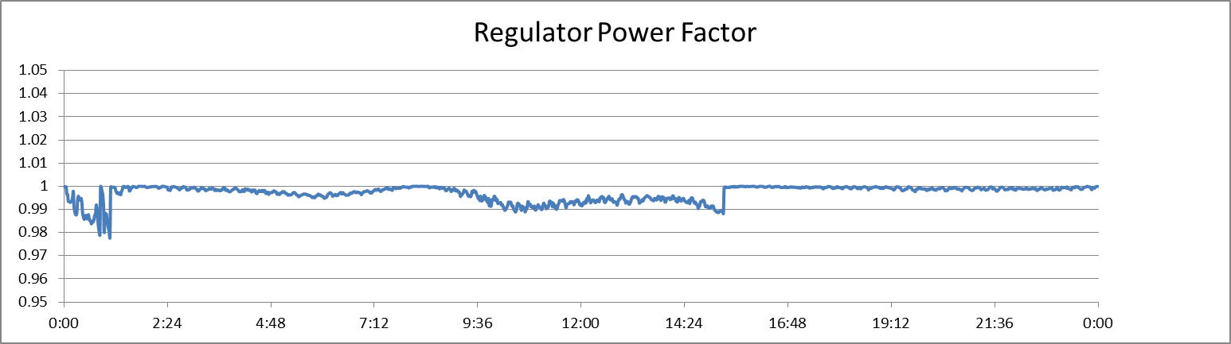



Case 3b
Implement Volt-VAR control measured at nodes 652 and 680.
The voltage at node 671 is better regulated.
The power factor is maintained.
$$\%VR_{A}=\frac{V_{min}−V_{peak}}{V_{peak}}=\frac{2444.47−2376.00}{2376.00}=2.88\%$$
$$\%VR_{B}=\frac{V_{min}−V_{peak}}{V_{peak}}=\frac{2429.39−2371.06}{2371.06}=2.46\%$$
$$\%VR_{C}=\frac{V_{min}−V_{peak}}{V_{peak}}=\frac{2429.71−2370.37}{2370.37}=2.50\%$$
P (kWh-hr) | 38,736
Q(kVAR-hr) | 1,933
S(KVA-hr) | 38,878

Slide 39
Modified IEEE 13 Node System with Volt-VAR Control
VAR Controlled Link
EOL Measurements

Slide 40
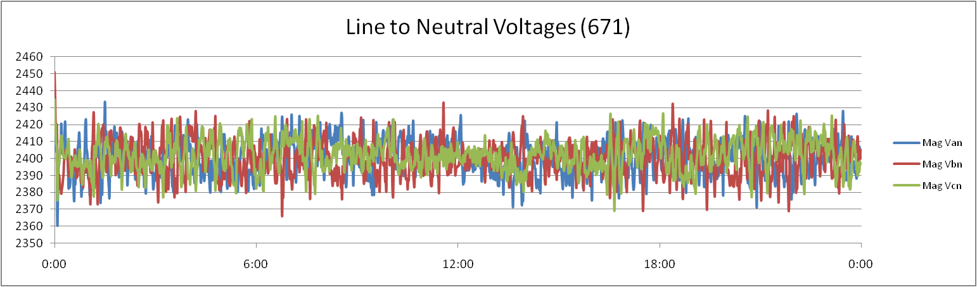
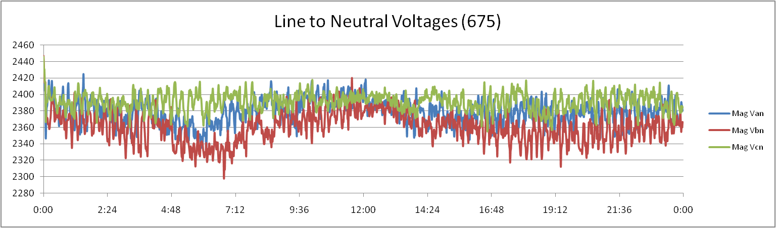
Case 1: Local Voltage Control
Voltage at node:671 is controlled by regulator to 2,400V:
Voltage at node:675 is maintained by capacitors:

Slide 41
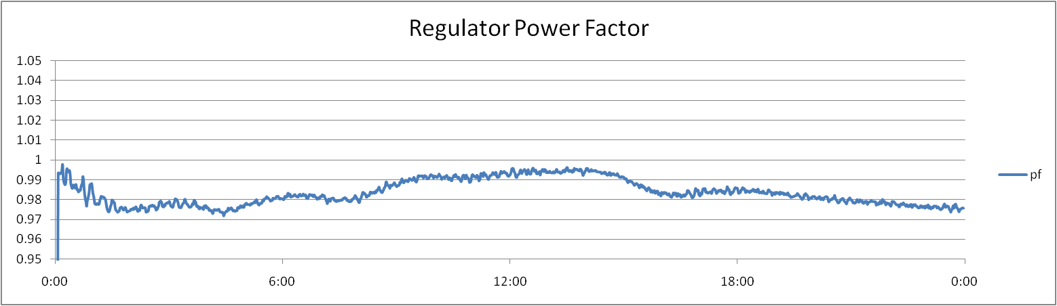
Case 1: Local Voltage Control cont.
Voltage is still operated at an upper level. As a result, there are energy reductions that are not realized.
Power factor is not maintained:

Slide 42
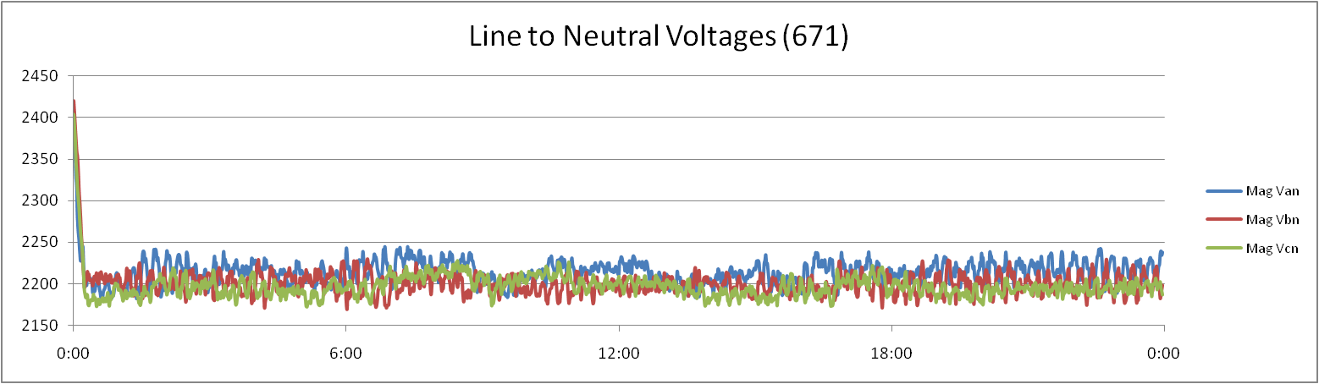
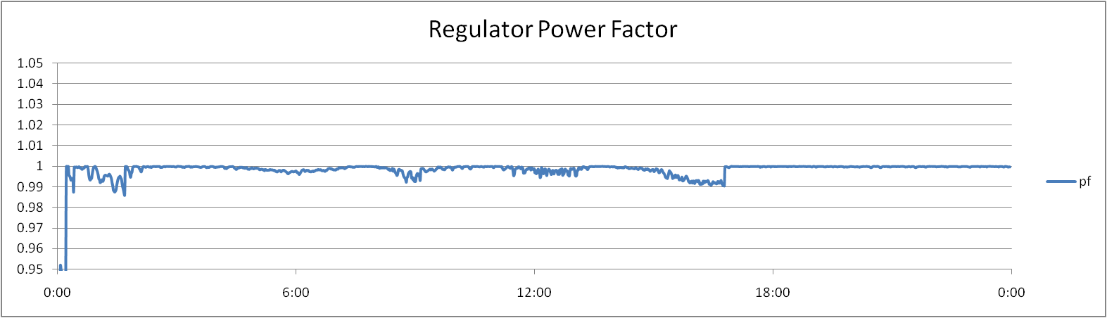
Case 2: Coordinated Volt/VAR Control
Voltage is regulated at remote nodes 652 and 680, to a values of 2,200V:
Energy consumption is reduced:
Power factor is maintained

Slide 43
Substation and Distribution Automation
Conclusion of Module 6: Volt-VAR optimization

